Slide 1
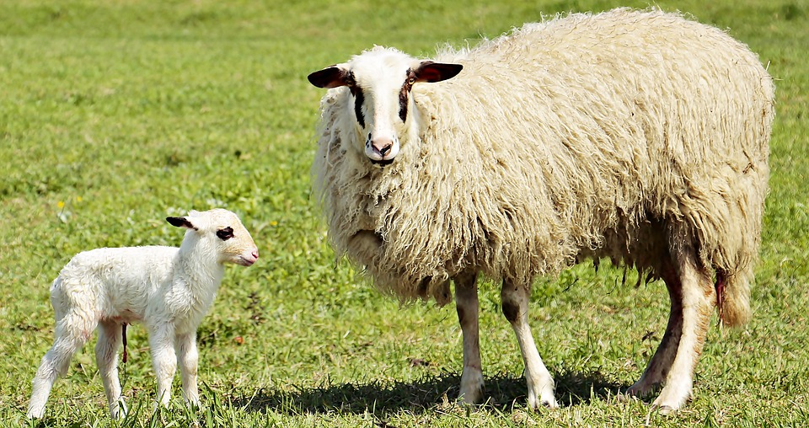







Stages of Meiosis

Slide 2
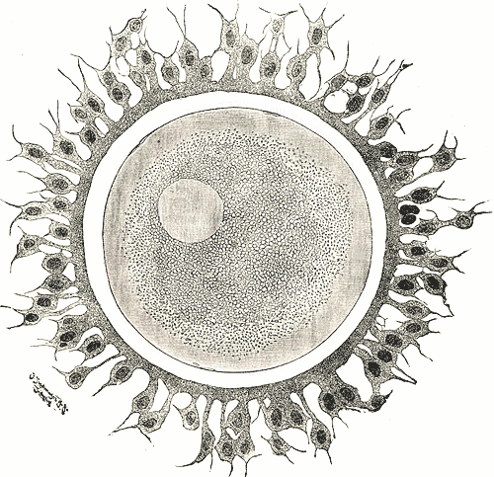
Like mitosis, meiosis also refers to how cells divide to produce new cells.
Sex cells or gametes are produced from meiotic division.

Slide 3
Meiosis is the M phase that leads to the production of either sperm cells or egg cells. This type of division is very closely tied with the process of sexual reproduction.

Slide 4
How does the reduction of the chromosome number occur in meiosis and why is this process important?

Slide 5
Meiosis and Its Function
production of functional sex cells or gametes
reduction in the chromosome number
Meiotic Division
two rounds:
meiosis I and meiosis II
allows restoration of original chromosome number during fertilization

Slide 6
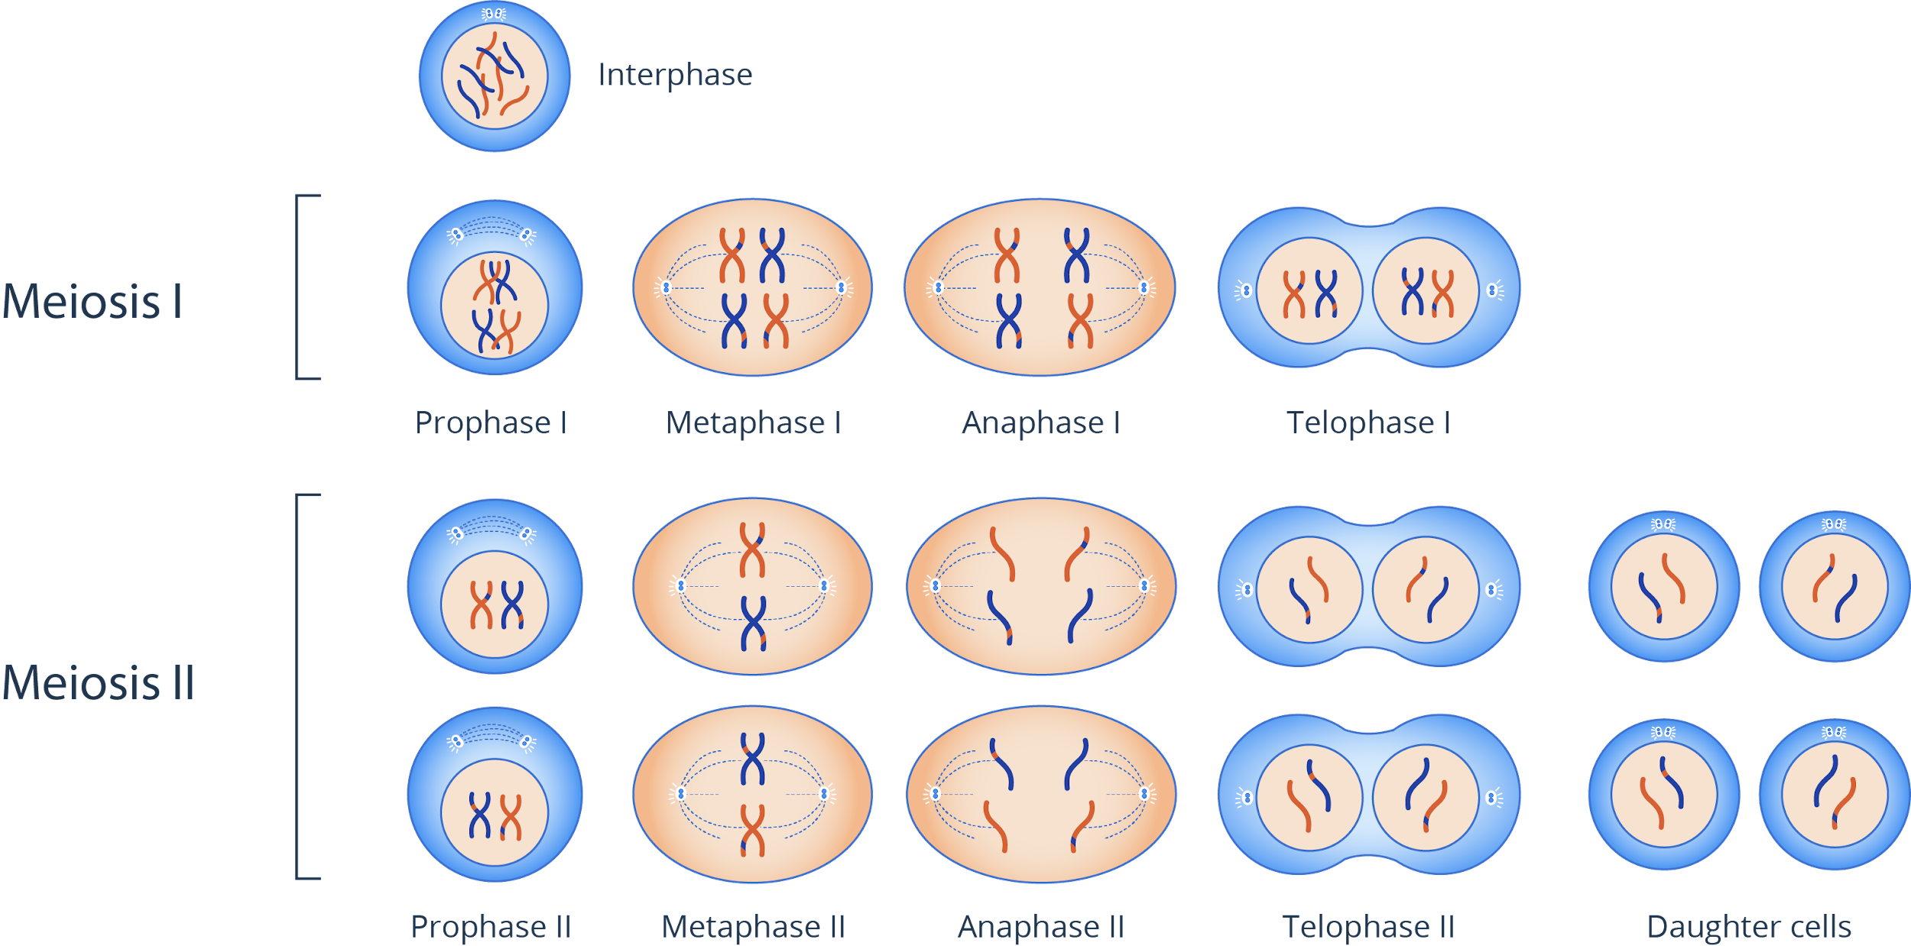
The Stages of Meiosis
Meiosis involves two rounds of cytokinesis which will ultimately produce four daughter cells with a reduced chromosome number.

Slide 7
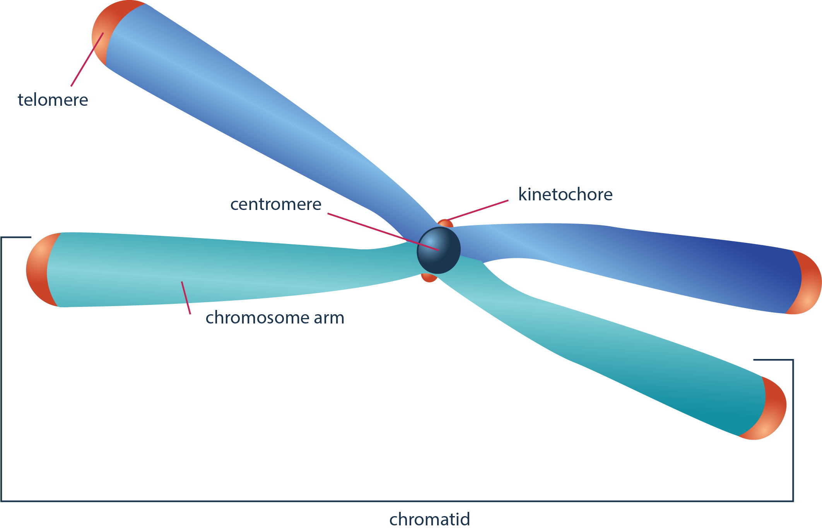
Meiosis I
Meiosis I comes after the G2 phase of the cell cycle.
starts with duplicated chromosomes
chromosomes are in sister chromatid conformation

Slide 8
Meiosis I
Prophase I
Prometaphase I
Metaphase I
Anaphase I
Telophase I
Condensation, synapsis, and crossing over
Meiotic spindle formation
Alignment at metaphase plate
Separation of homologous pairs
Formation of daughter cells
1
2
3
4
5
Meiosis I is a REDUCTIONAL division.

Slide 9
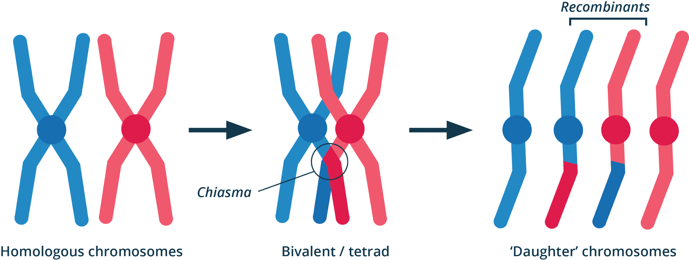
Meiosis I
Prophase I
chromosome condensation

Slide 10
Meiosis I
Prophase I
chromosome condensation
synapsis between homologous pairs

Slide 11
Meiosis I
crossing over between homologous pairs
Prophase I
chromosome condensation
synapsis between homologous pairs

Slide 12
Meiosis I
crossing over between homologous pairs
Prophase I
chromosome condensation
synapsis between homologous pairs
chromosomes after meiosis

Slide 13
Meiosis I
Prometaphase I
further chromosomal condensation
further disintegration of nuclear envelope
meiotic spindle formation

Slide 14
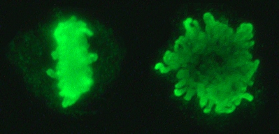
Meiosis I
Maternal and paternal chromosomes are randomly arranged.
Metaphase I
alignment of the homologous chromosomes at metaphase plate
facilitates reduction in chromosome number

Slide 15
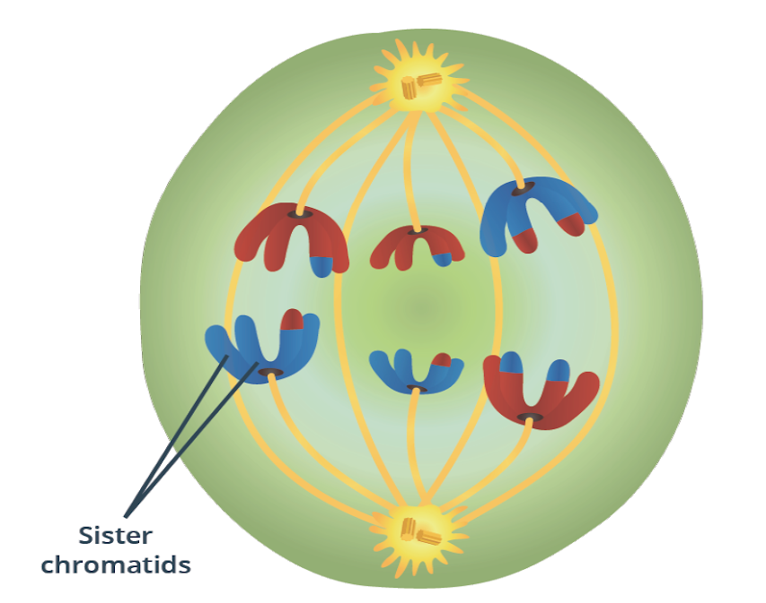
Meiosis I
Anaphase I
Maternal and paternal members move to either pole.
paternal member
separation of the homologous pairs
maternal member

Slide 16
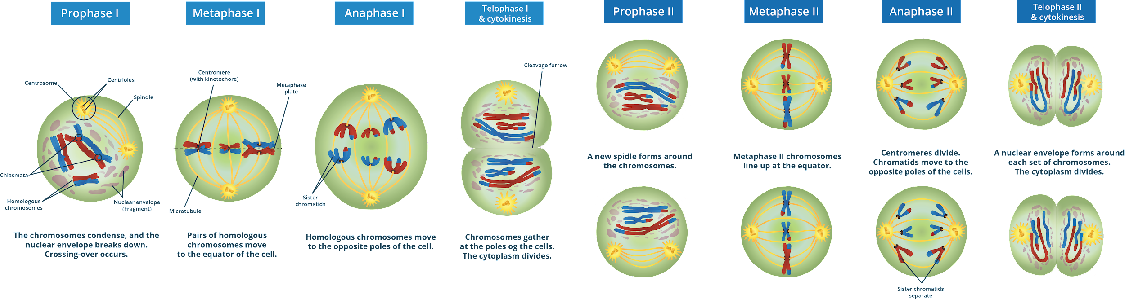
Meiosis I
Telophase I and Cytokinesis
n = 3
Chromosomes reach opposite poles.
the cytoplasm divides
n = 3

Slide 17
What will happen to the daughter cells if synapsis and recombination do not occur?

Slide 18
Meiosis II
Prophase II
Prometaphase II
Metaphase II
Anaphase II
Telophase II
Preceded by an interkinesis, chromosomes recondense
Disintegration of the nuclear envelope
Separation of sister chromatids
Alignment of the duplicated chromosomes
Formation of daughter cells
1
2
3
4
5
Meiosis II is an EQUATIONAL division.

Slide 19
Meiosis II

Slide 20
Meiosis II

Slide 21
Meiosis II

Slide 22
Meiosis II

Slide 23
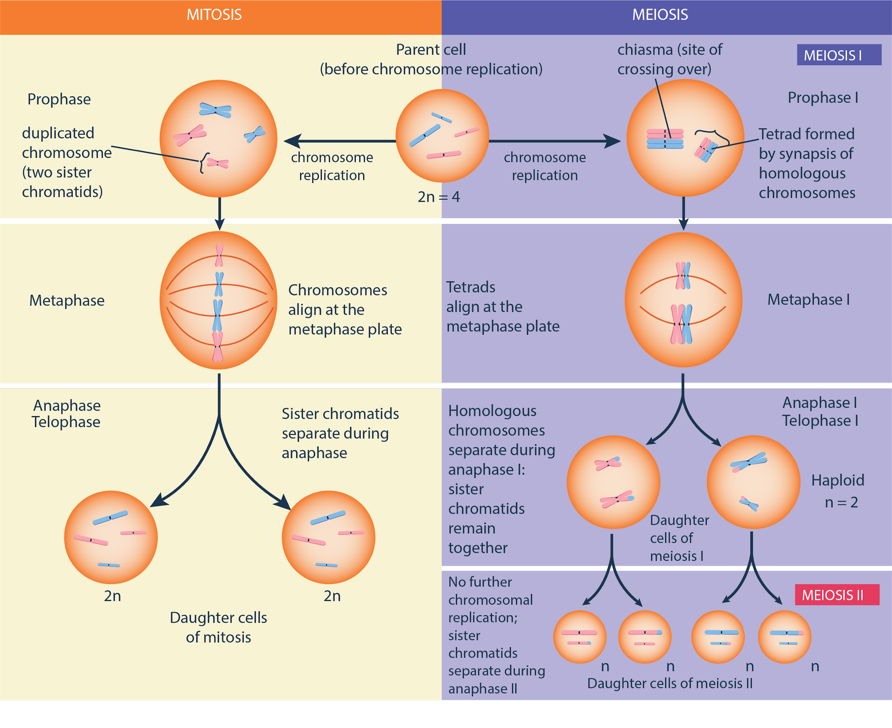
Differences between Mitosis and Meiosis

Slide 24
Do you still get the cells and cell division types mixed up?
To help you remember which is which, never forget the mnemonic devices MiSo and MeGa.
MiSo: Mitosis for Somatic Cells
MeGa: Meiosis for Gametes

Slide 25
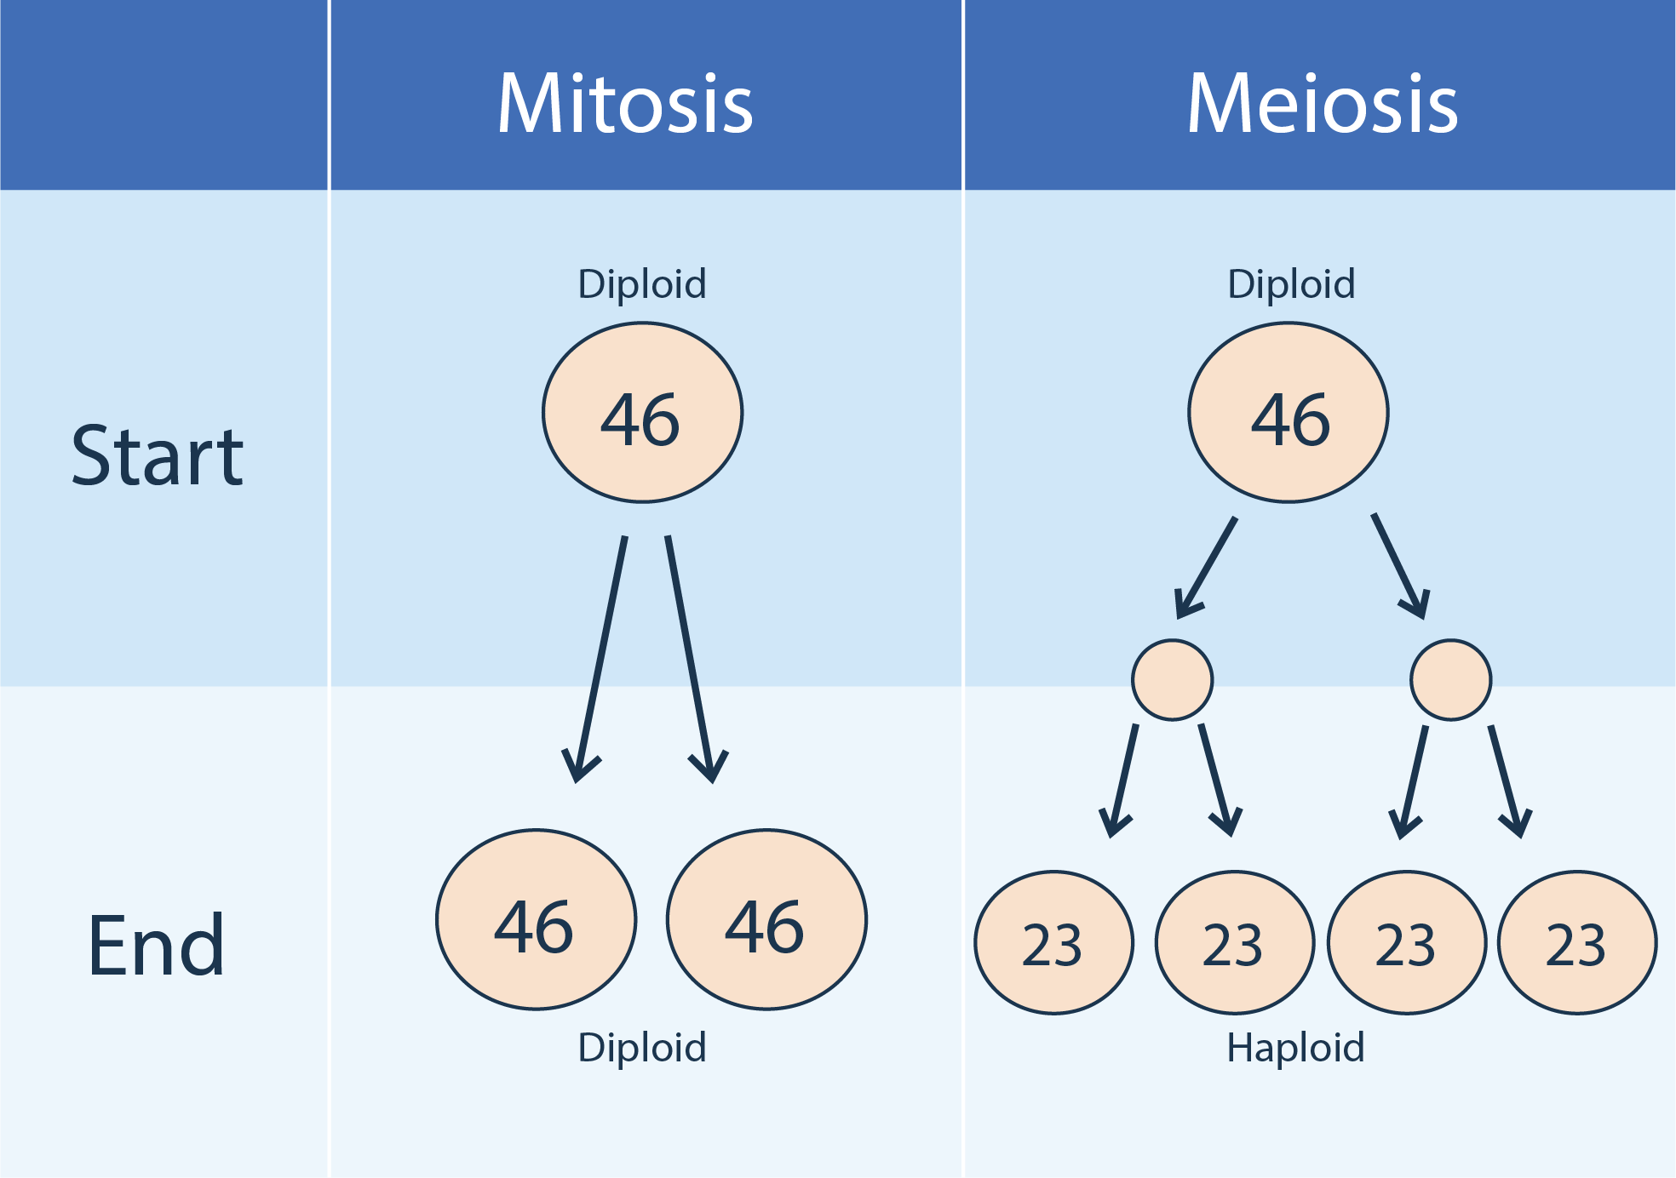
Differences between Mitosis and Meiosis
Differences between human mitosis and meiosis in terms of the number of chromosomes of the daughter cells

Slide 26
Mitosis maintains an identical set of genetic material in the daughter cells whereas meiosis reduces this amount and introduces new combinations.
These have different consequences and applications as a result.

Slide 27
Difference between Meiosis I and Meiosis II
Synapsis occurs only in meiosis I.
Crossing over occurs only in meiosis I.
Meiosis I vs. Meiosis II
Tetrads line up and separate into individual homologous chromosomes in meiosis I.
Sister chromatids line up and separate into individual chromosomes in meiosis II.

Slide 28
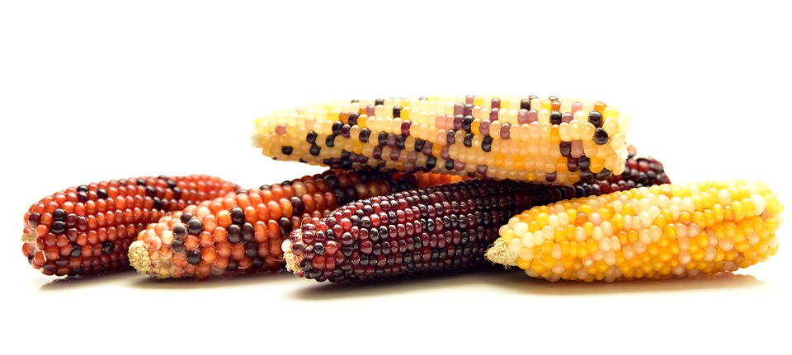
Crossing Over
facilitates genetic recombination
enhances genetic variation
IMPORTANCE OF CROSSING OVER
increases chances of survival

Slide 29
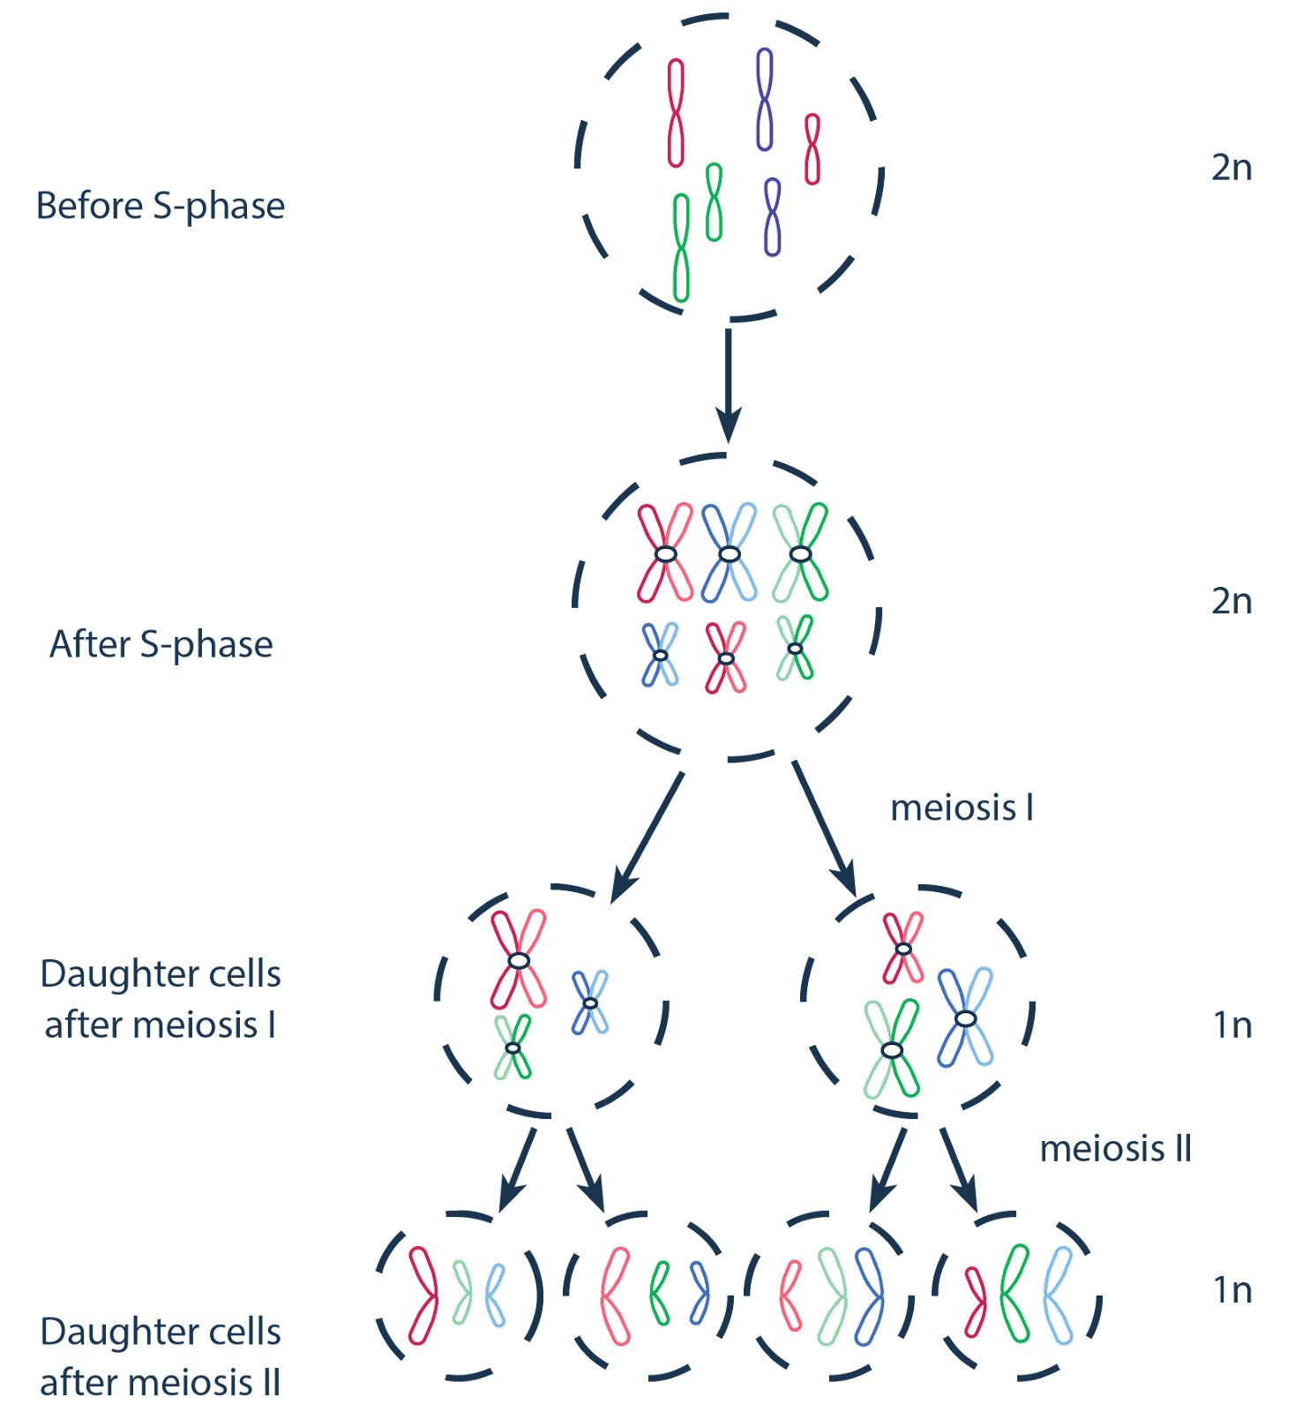
Changes in Number of Chromosomes
Chromosomes are assumed to be single at G1 phase (2n = 6).

Slide 30
Changes in Number of Chromosomes
Chromosomes are assumed to be single at G1 phase (2n = 6).
Chromosomes are duplicated by the end of S phase
(2n = 6).

Slide 31
Changes in Number of Chromosomes
Chromosomes are assumed to be single at G1 phase (2n = 6).
Chromosomes are duplicated by the end of S phase
(2n = 6).
Duplicated chromosomes enter meiosis I
(2n = 6).

Slide 32
Changes in Number of Chromosomes
Chromosomes are assumed to be single at G1 phase (2n = 6).
Chromosomes are duplicated by the end of S phase
(2n = 6).
Duplicated chromosomes enter meiosis I
(2n = 6).
Chromosome number is reduced after meiosis I (n = 3).

Slide 33
Changes in Number of Chromosomes
Chromosomes are assumed to be single at G1 phase (2n = 6).
Chromosomes are duplicated by the end of S phase
(2n = 6).
Duplicated chromosomes enter meiosis I
(2n = 6).
Chromosome number is reduced after meiosis I (n = 3).
Sister chromatids are separated after meiosis II (n = 3).

Slide 34
The process of sexual reproduction requires a reduction in the chromosome number. This is achieved through meiosis, the type of cell division that produces gametes or sex cells.

Slide 35
Unlike mitosis, meiosis involves two rounds of divisions, namely, meiosis I and meiosis II. Meiosis II immediately takes place after meiosis I, so only the latter is preceded by the duplication of genetic material.

Slide 36
Aside from the number of daughter cells produced, meiosis is also different from mitosis in terms of its unique events.
Synapsis involves the pairing of the members of homologous chromosomes so as to allow them to undergo crossing over and to segregate them.

Slide 37
Aside from the number of daughter cells produced, meiosis is also different from mitosis in terms of its unique events.
Crossing over refers to the exchange of segments between non-sister chromatids of homologous chromosomes. Ultimately, this enhances the genetic diversity of species.

Slide 38
Meiosis I is considered the reductional division in meiosis because it reduces the number of sets of chromosomes from two to one. Meiosis II, by contrast, is considered the equational division in meiosis because there is no further reduction of the chromosome number in daughter cells.

Slide 39
Meiosis I and II are also different in terms of the segregating elements. Meiosis I entails the separation of the members of the homologous chromosomes, whereas meiosis II involves the separation of the sister chromatids.

Slide 40
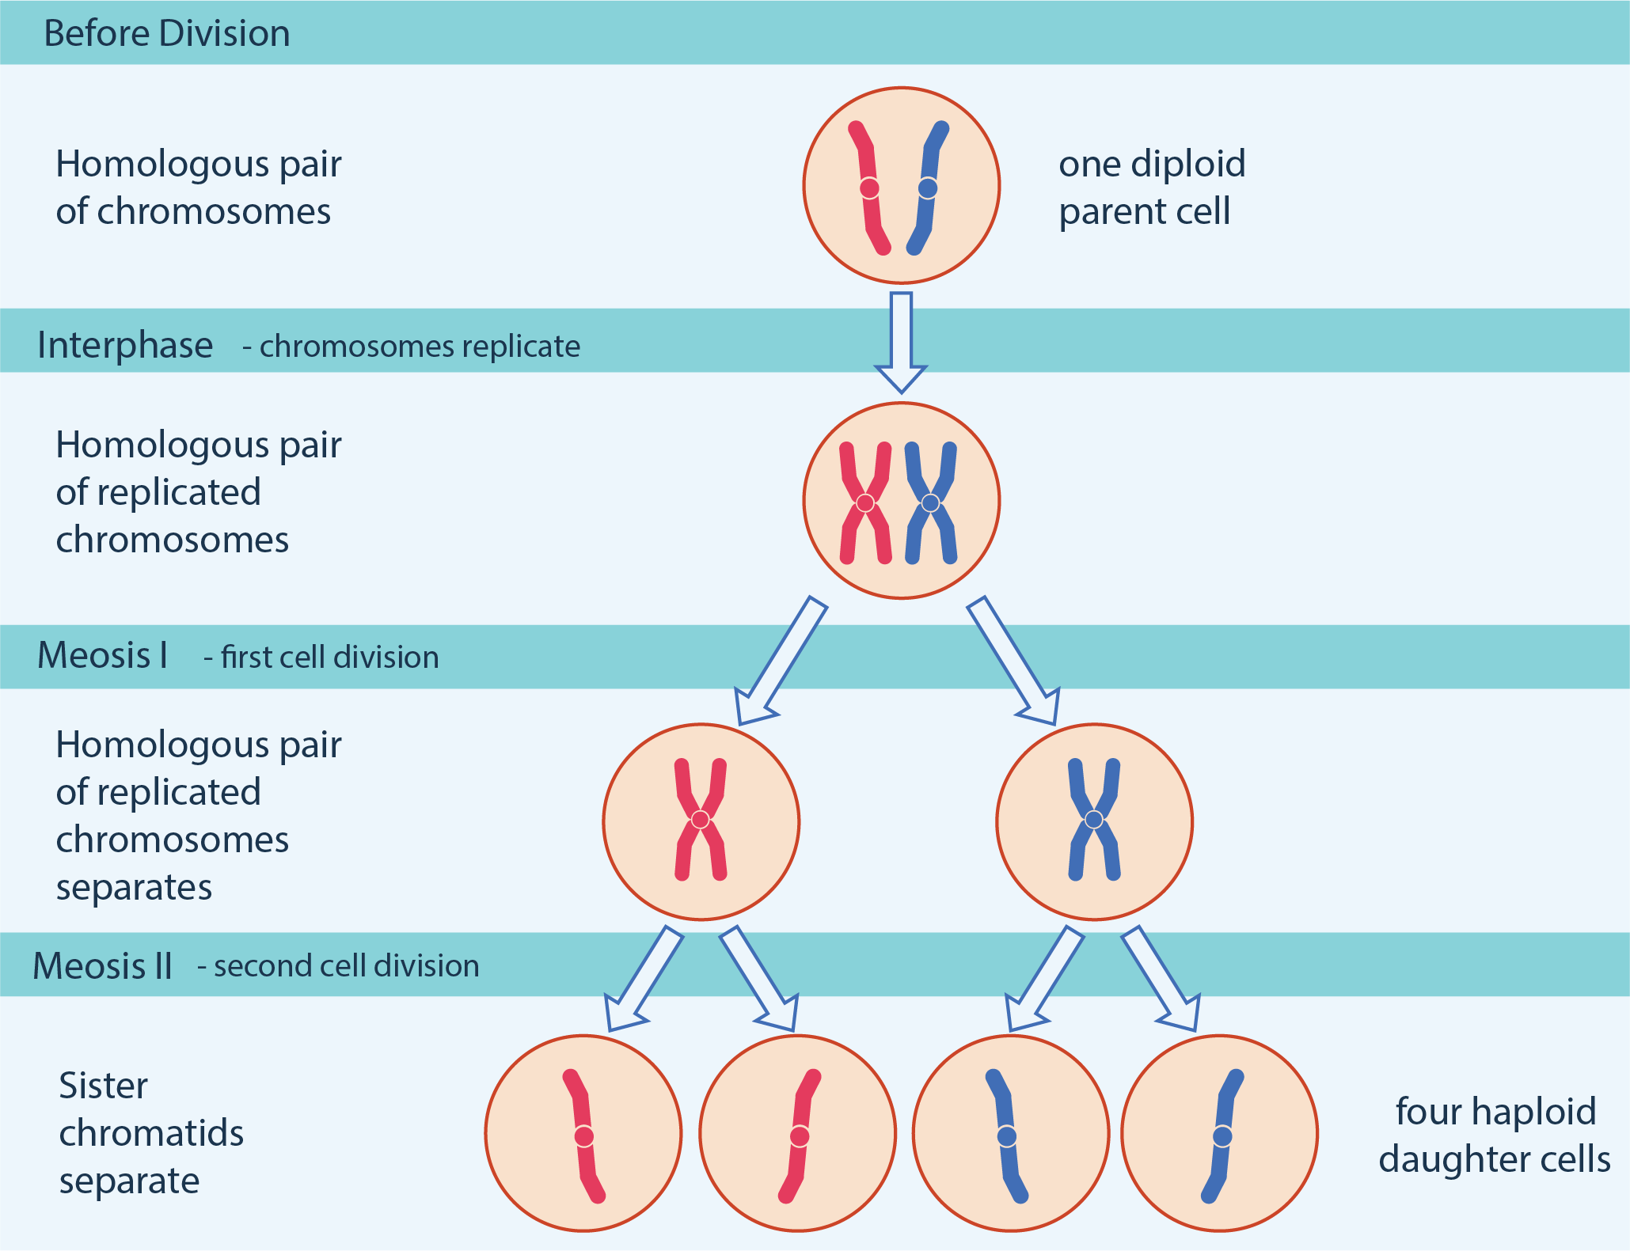
Meiotic division can be described according to the number of divisions, number of daughter cells, and the unique events that take place.

Slide 41
How does meiosis contribute to genetic diversity?

Slide 42
Slide 17: Metaphase_chromosomes.jpg by Simoncaulton, is licensed under CC BY-SA 3.0 via Wikimedia Commons.

Slide 43
Boyer, Rodney F. Concepts in Biochemistry. Hoboken, NJ: Wiley, 2006.
Hickman, Cleveland P. Integrated Principles of Zoology. New York, NY: McGraw-Hill, 2011.
Miller, Stephen A., and John P. Harley. Zoology. New York, NY: McGraw-Hill, 2010.
Russell, Peter J. Biology: the Dynamic Science. Student Ed. Belmont, CA: Thomson/Brooks/Cole, 2008.
Starr, Cecie, Ralph Taggart, Christine A. Evers, and Lisa Starr. Biology: the Unity and Diversity of Life. Boston, MA: Cengage, 2019.

